Slide 1
Extremely high performance persistent message queue by SocketPro
Yuancai (Charlie) Ye
support@udaparts.com
http://www.udaparts.com

Slide 2
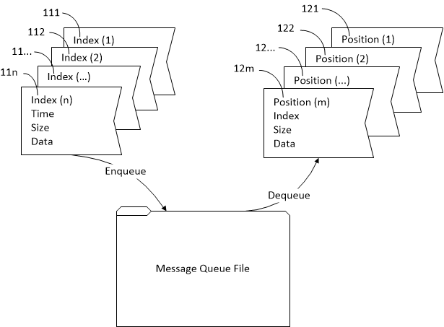
Key Features
Messages stored sequentially and lineally by FIFO
Support publish and consume at the same time
Consuming messages in batch
Extremely high performance (>150,000 messages per second for enqueuing and > 90,000 messages in dequeuing)
Guarantees (at-least-once and exactly-once)
Transactional enqueuing and dequeuing (StartJob, EndJob and AbortJob)
Consuming (Pull and Push)
Auto-consuming and auto-confirmation
Async and batch transferring automatically and silently among applications
Cross-platforms and cross-dev languages
Secure
Replicate messages across the network
Very simple for reuse!

Slide 3
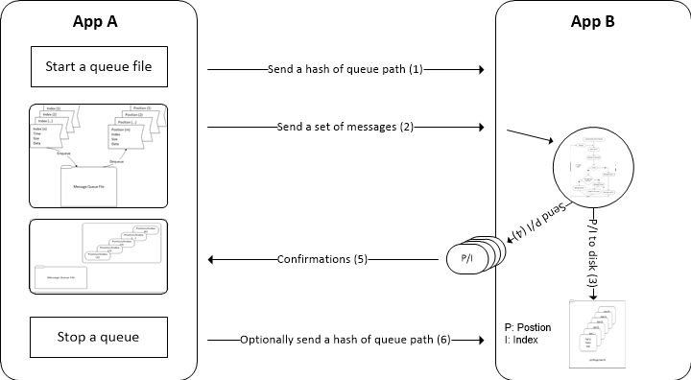
Messages Flow Activities by SocketPro

Slide 4
SocketPro Sharable Queue
Producer 0
Producer 1
Producer n
SocketPro Persistent Queue File
Consumer 0
Consumer 1
Consumer 2
Consumer m

Slide 5
Persistent Queue Interfaces
public interface IMessageQueueBasic {
void StopQueue();
void StopQueue(bool permanent);
ulong CancelQueuedMessages(ulong startIndex, ulong endIndex);
ulong RemoveByTTL();
void Reset();
bool AbortJob();
bool StartJob();
bool EndJob();
uint MessagesInDequeuing { get; }
ulong MessageCount { get; }
ulong QueueSize { get; }
bool Available { get; }
bool Secure { get; }
string QueueFileName { get; }
string QueueName { get; }
ulong JobSize { get; }
bool DequeueShared { get; }
ulong LastIndex { get; }
tagQueueStatus QueueStatus { get; }
uint TTL { get; }
DateTime LastMessageTime { get; }
}
public interface IClientQueue : IMessageQueueBasic {
bool StartQueue(string qName, uint ttl);
bool StartQueue(string qName, uint ttl, bool secure);
bool StartQueue(string qName, uint ttl, bool secure, bool dequeueShared);
bool AppendTo(IClientQueue clientQueue);
bool AppendTo(IClientQueue[] clientQueues);
bool AppendTo(IntPtr[] queueHandles);
bool EnsureAppending(IClientQueue clientQueue);
bool EnsureAppending(IClientQueue[] clientQueues);
bool EnsureAppending(IntPtr[] queueHandles);
bool DequeueEnabled { get; }
bool RoutingQueueIndex { get; set; }
IntPtr Handle { get; }
}
What about IServerQueue?

Slide 6
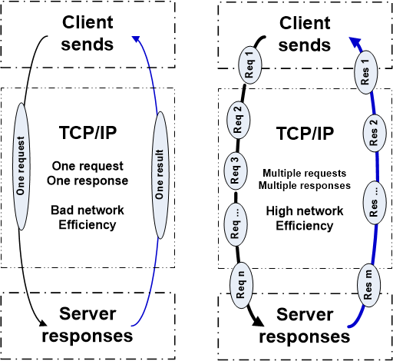
SocketPro Communication Model (Request batching, asynchrony and parallel )

Slide 7
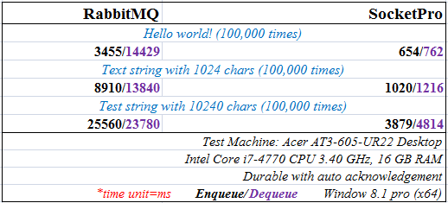
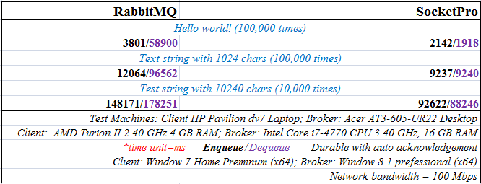
SocketPro Queue vs RabbitMQ http://www.udaparts.com/document/articles/fastsocketpro.htm

Slide 8
Demo One with C#/Java/Python
Client message queue for guaranteed request delivery over instable network

Slide 9
Demo Two with C#/Java/Python
A Filterable Server Queue

Slide 10
Demo Three with C#/Java/Python
Auto failure recovery Load balancing with affinity

Slide 11
Demo Four with C#/Java/Python
Replication with SocketPro Persistent Queue

